Slide 1

Natural Language Processing Mini Project
Topic:
NLP based Market Basket Analysis : stores to analyse the products their customers purchased/customers’ baskets to know how they can generate more profit.

Slide 2
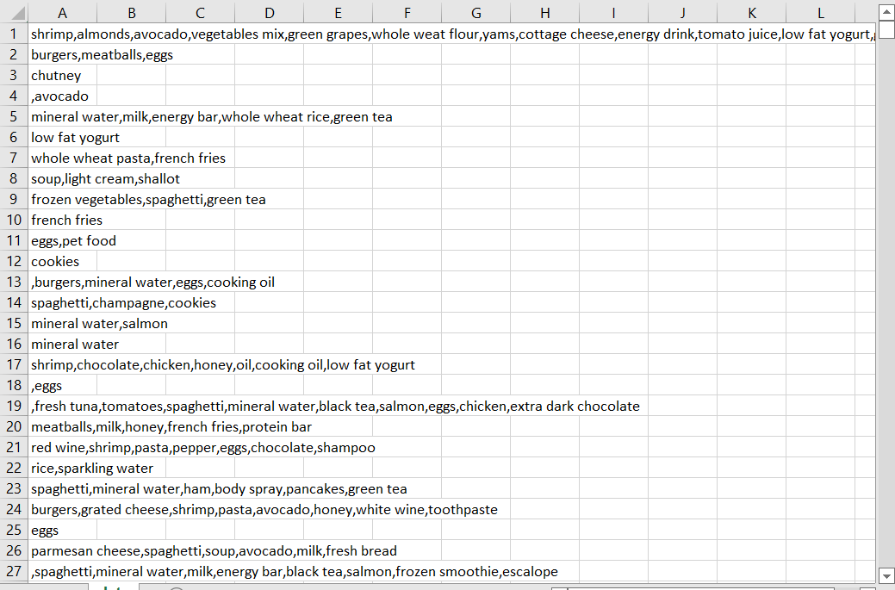
Dataset

Slide 3



Central Idea
How to generate profits after analyzing customer baskets?
Popular or in demand products
Pattern in buying products
Arrangement of products
The store’s scope and application

Slide 4
Conclusion
Association, exploratory data analysis can provide meaningful insights
Insights -> discounts, offers ->help in increasing the business

Slide 5
Thank you

